Slide 1
Enjoy Unimportant Things
Yung-Yu Chen
2016/4/15
Jobspace

Slide 2
Why We Hold Jobspace
A community of
Diversity. We’ve prepared frontend technology and knowledge discovery after this kick-off meetup. More topics are being conceived. Attendees can enjoy a broad range of topics.
Knowledge. We invite experienced speakers and work together for a quality talk in each meetup.
Interaction. We make the surroundings as comfortable as possible to bolster vibrant discussions. We use the talk to gather people of matching interests. We expect attendees to get as much from each other as from the speaker.
We invest time and money for such a community. Attendees only need to come and enjoy.
We listen to you and make things happen. You don’t need to be a volunteer.
Notes:
Thank you everyone for coming to Jobspace. I am especially thankful for your support because this meetup has a very different setting than most other in Taiwan. First I think I should start with introducing myself. I am working as a programmer in a software company. I am very enthusiastic about open source, and has founded the Taiwan PyCon since 2012. I founded Python Hsinchu User Group, PyHUG, in this region, and have held and attended many technical meetups. Before I did this in Taiwan, I’ve also participated some open-source user groups in United States. I put a lot of efforts to enjoy myself in technical discussions with bright developers, and I also put a lot of efforts to bring this kind of fun to people.
I like to call myself “party planner”, because I think this kind of meetups or activities for technology have the very nature of social purpose. It is natural for people to get together and share freely their thoughts. It’s especially important for technological development. Many people writing about how to be “innovative”, and it is a common sense that critical discussions are a key to innovation. I personally have the same experiences and I believe it. So this is why we want to start Jobspace. I’ve tried many years with PyHUG. It has its own virtue, and I like it very much, but I cannot give it more diversity than Python, which is obvious. And I think it’s important to bring in more knowledgeable speakers. With a free event it is very difficult to get enough money to invite speakers from outside Hsinchu. In Jobspace, we have a box office, and the money will support transportation of speakers, and also help us to provide a good place for the meetup.

Slide 3
About This Talk
We will start with a little bit about Science
Etymology: Scientia (Latin)
Knowledge based on demonstrable and reproducible data (Merriam-Webster Dictionary)
John Ruskin, The Eagle’s Nest (1872)
“In science you must not talk before you know. In art you must not talk before you do. In literature you must not talk before you think.
To know, is the ultimate goal.
Reality: Human works barely work.
#gotofail
To reach the truth, defy illusion, we have to work hard to ensure we aren’t getting things wrong.
if ((err = SSLHashSHA1.update(&hashCtx, &serverRandom)) != 0)
goto fail;
if ((err = SSLHashSHA1.update(&hashCtx, &signedParams)) != 0)
goto fail;
goto fail;
if ((err = SSLHashSHA1.final(&hashCtx, &hashOut)) != 0)
goto fail;
Notes:
To know is the utmost pleasure I can find in this world. Today we are here to talk about technology, so it may sound a little bit weird to have “science” at the beginning. But this is really the origin of why we are all here, why we’d like to spend our time to learn things that we do not know let, and why we are willing to advance our skills, by spending numerous nights reading, trying, and building.
We are not as faithful as Mother Nature.
As a developer I am always amazed that my code works. This is a quote I saw somewhere I don’t remember but I totally agree.

Slide 4
Computational Science for Fluid Mechanics
Computational Fluid Dynamics (CFD) in the Context of Aerospace Applications
Notes:
Computational science is the so-called third paradigm of science. We are all familiar with the first two paradigms. The first one, is experiment. The second one, is theory. This third one, is to use digital computers to obtain results that neither experiments nor theories can deliver.
In theory, by conducting computational research, we can be more flexible than pure theory, and provide more detail than experiments along.
Obviously, programming skills are important to computational sciences. Today I want to start with CFD, computational fluid dynamics, to show you how to specialize programming in its applications, and how the skills are generalized and extended to other applications. I will focus on aerospace, where CFD is critically important.

Slide 5
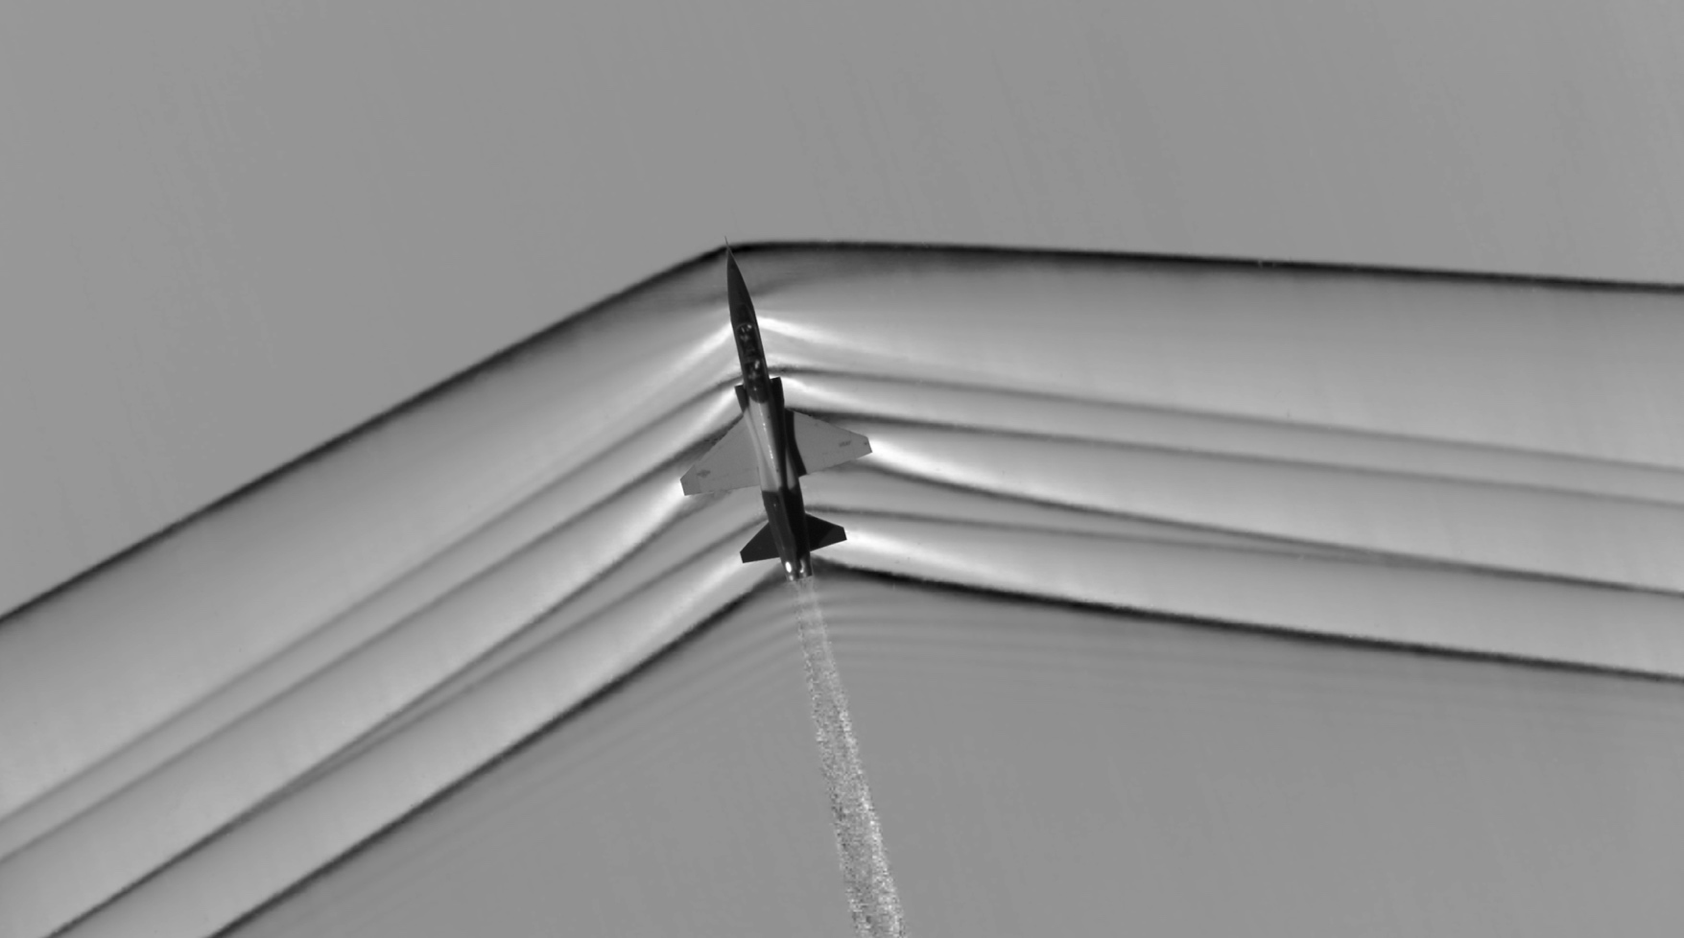
To See before to Know
Image of density gradient: Schlieren photography
Invented 150 years ago in 1864 by August Teopler
Recently developed to be applied outside laboratory.
Shock waves imaged with a full-scale supersonic vehicle in flight.
http://go.nasa.gov/230fQOa
Notes:
Seeing is believing. Experimenting is the final guard to prove or disprove our ideas. Here I am showing shock waves. They are important phenomena for flight. Across a shock, the flow properties have abrupt change, and it is important to capture the location for shocks. But here we don’t need to talk about any detail of the physics. What we need to know is that it is very difficult to use theories to precisely predict the shock location. The way it is usually done is to do experiments or CFD.
Seeing shock waves in realistic flows is difficult. One technique we used in laboratory is the so-called Schlieren photography. It visualizes the gradient of the density. Because the abrupt change of shocks includes density, so this technique can successfully show the shocks.
But this technique is very old. It was invented in 150 years ago, by a German scientist. And it had stayed in laboratory for more than a century. Only in recent years, by using the power of digital computers, we can write image processing software to help us to make Schlieren diagrams for vehicles in real flight. Before this, we can only draw the Schlieren graphics for scaled model in a wind tunnel.
So here I give a simple demonstration that how difficult it is to do experiments, and how limited the approaches we have.

Slide 6
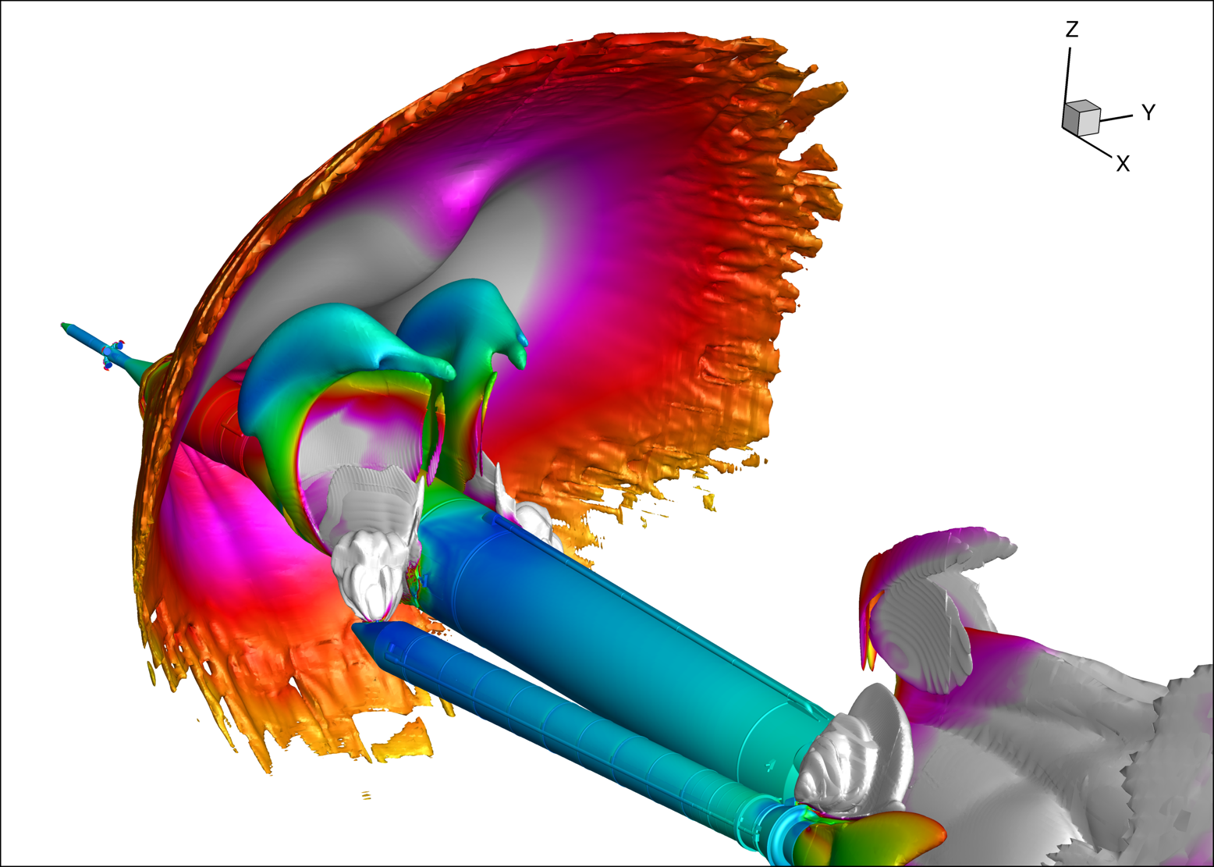
To See More to Know More
CFD (computational fluid dynamics) gives you much more.
Pressure plots of shocks and the plumes for booster separation of NASA’s Space Launch System (SLS).
http://go.nasa.gov/1Vl9B1p
Notes:
CFD helps us to see much more. Once we can model the physics in a computer, we can show very detailed structure of the fluid flow, like this picture. This is a pressure plots on the shocks and the plumes during the booster separation of a very strong rocket made by NASA. This big guy carries 3 times the payload of a space shuttle.
We can see the fine structures in the fields. But in addition to the colorful image, the most important thing is that by running 22,000 simulations like this, NASA uses CFD to fill the parametric space describing the booster separation event. This is a huge budget save. Imagine how much money it costs to fly this thing 22,000 times for doing experiments. You won’t do it.
But even in CFD it is quite costly. This study took NASA 12.7 million CPU core-hours. Although comparing to experiments it’s nothing, this is still a stunning number of computing power consumption.

Slide 7
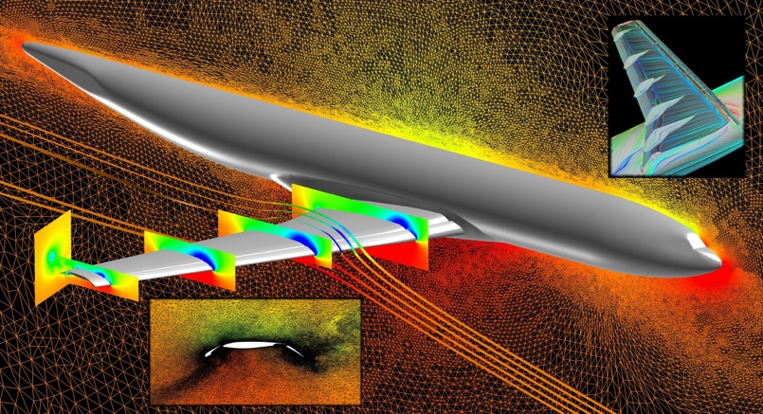
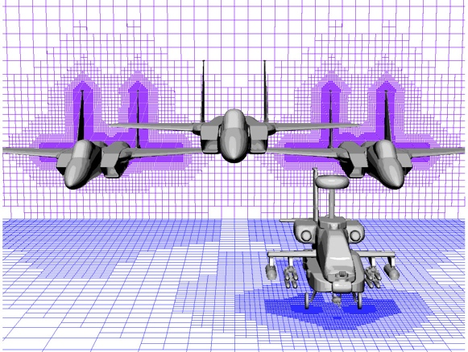
What a Solver Needs to Do
Data input.
Spatial geometry (meshes): Unstructured mesh or structured mesh.
Parameters. Sometimes logic.
Execute numerical method for the governing equations.
Conservation laws, constitutive models, and process models.
The distributed-memory parallel programming is a must for high-performance computing (HPC).
Data output.
Big volume of storage: With the resolution of 50 million elements and a minimal of 5 variables on each element, each time step takes 1GB space.
A normal run of 10,000 steps can eat 10TB if we do it naively.
http://go.nasa.gov/1S36OaS
http://go.nasa.gov/23ldny1
Notes:
OK, enough physics. Now I will talk about what does it take to develop a CFD solver? In principle a CFD program is just a computer program. And it has three critical parts.
The first one is the input processors. People tend to think the numerical algorithms are the most important part. I cannot say it is wrong, but first, we usually don’t use the term “algorithm”, but we call it “numerical methods”. Second, it’s extremely sensitive to garbage input. We need to do a lot of work to define the computing domain, the space that the flows exist, then we can satisfy the requirement of numerical methods. We also need to make sure all the parameters are correct. Usually the parameters take quite some calculation before we know the input values. It is desirable if we can input both values and logic for a solver and its numerical methods.
The second part is the numerical method. The numerical methods are implemented for the mathematical equations that define the physical processes. Here for CFD we care about the conservation laws and the constitutive models employed. And to gain speed there’s no way around distributed-memory parallel computing to achieve HPC.
Finally, the third part involves showing the results. Most CFD codes output data sets for some visualizers in a post-processing phase. If we take this approach, which is the usual case, we will consume a lot of disk space. Of course it is not realistic to store 10TB per simulation, so people usually will reduce the resolution or output frequency. It is not an ideal strategy. So you can see we have serious challenges in this part too.
The pictures show two different ways to describe the computing domain. The left one shows the unstructured mesh. Unstructured mesh uses irregular-shaped elements, and can fit a complex body. The right one is the structured mesh. Structured mesh uses regular-shaped elements, but it has difficulty in fitting complex geometry. But what you see here, is a use of adaptive refinement of the Cartesian mesh elements, so the stair casing effect is reduced to minimal. Very clever.

Slide 8
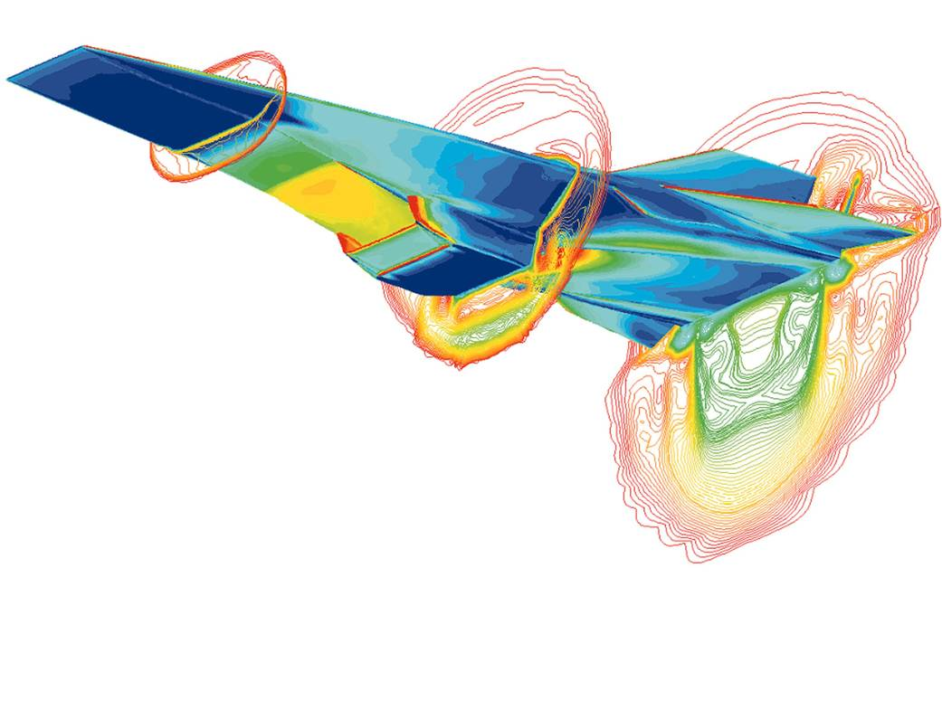
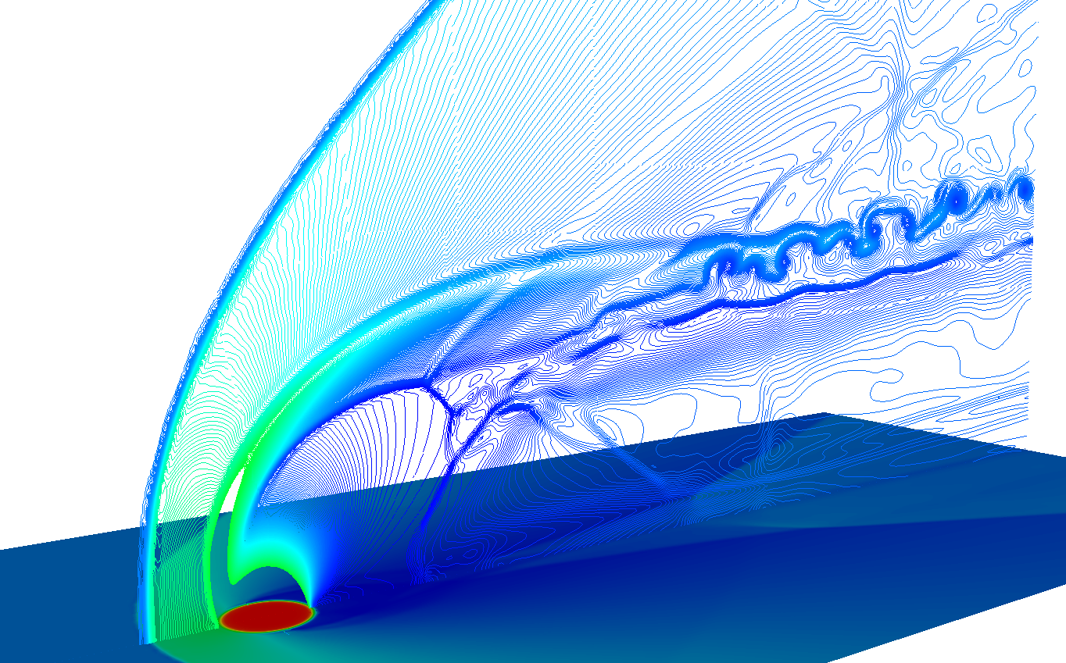
What Else to be Done
Visualization and analysis.
Conventionally scientists use a post-processer to visualize the simulations.
The huge amount of data pose difficulty to this approach.
Scripting and automation.
Portability and then reproducibility.
Using hundreds to thousands of slave nodes is normal.
Easy to get entangled with environment.
http://go.nasa.gov/232db6E
Notes:
In addition to the code tightly coupled with the simulation, there are other necessary component that a solver software needs to address.
The first thing is visualization and analysis. We need to see the results that we simulate. Later we’ll exhibit the the complexity embedded in the solver core. Because of the complexity, most people choose to output data from the solver and then visualize in a post-processor. This two-step approach successfully reduces the challenges in coding. However, dumping all data to disks is very demanding to hardware. If we can be smarter and do visualizing and analysis hand-in-hand with solving, we’ll have a big gain.
The second thing is automation. For parametric studies it’s necessary to have some scripting capability. A parametric study usually involves hundreds or thousands of runs. Even if the solver doesn’t support scripting, we’ll need to write scripts to manage the input files of the solver software, and to provision the simulations.
The third thing is reproducibility. Although it sounds like a basic requirement for any software, it’s not always true for a scientific code. Ironically, a scientific code should be the most demanding for the correctness. But given the complexity of the software and the involved knowledge, it won’t be hard to imagine why some codes only work on the developers’ computers.
In the following slides, I am going to show you a little bit about the complexity I am talking about.

Slide 9
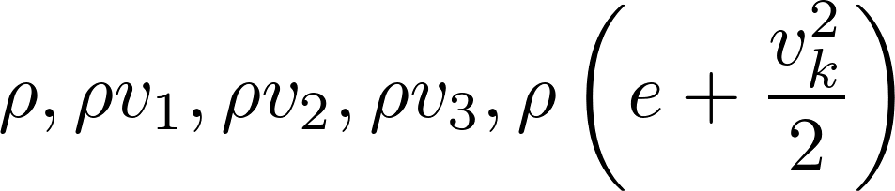
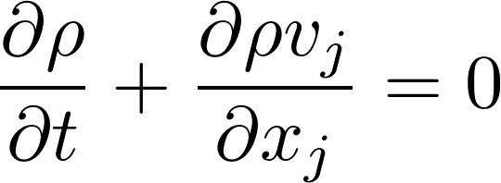
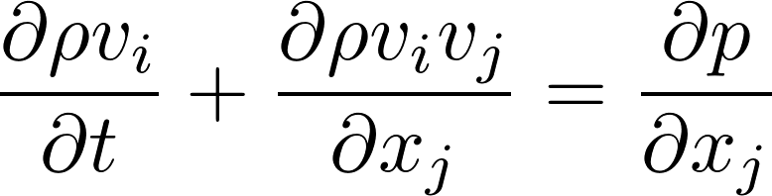
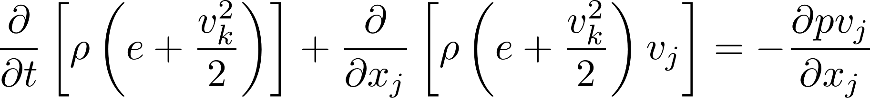
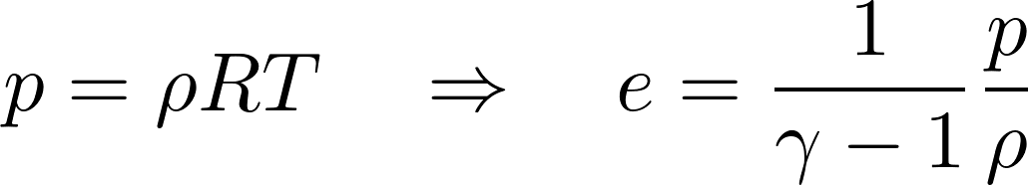
The Equations to Solve
Consider the inviscid Euler equations for supersonic flows.
5 independent variables:
Conservation of mass:
Conservation of momentum:
Conservation of energy:
Equation of state:
We end up with a system of hyperbolic partial differential equations (PDEs), also known as conservation laws.
Employ Einstein’s summation convention for the Cartesian tensors.
Notes:
All the pictures I showed before are the solutions of the so-called Euler equations. The Euler equations are the governing equations of gas dynamics when we don’t need to consider friction. You think, wait, we don’t need to consider friction? Yes. When the flow speed is fast enough, friction is only effective in very limited regions. In some cases we will consider friction, and then we need to solve the Navier-Stokes equations. But in many practical cases, the Euler equations are grabbing our attention.
I won’t spend much time in this slide. The only point I want to make here is that the Euler equations are hyperbolic partial differential equations. So CFD is about solving hyperbolic partial differential equations efficiently. And because the equations come from the fundamental conservation of physics quantities, we also call the equations “conservation laws”.

Slide 10
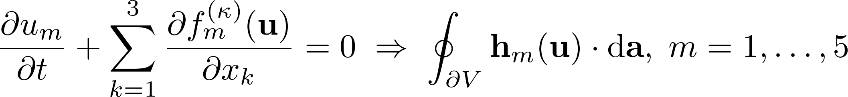
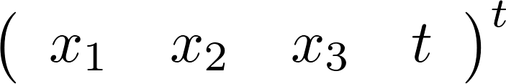
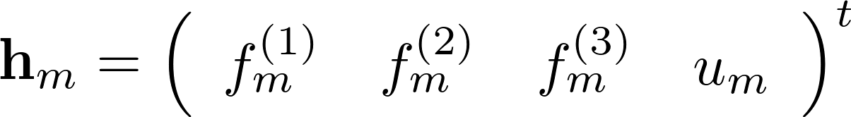
How to Solve
The embedded nonlinearity results into shocks. Continuous solutions of the differential equations do not exist.
“The shocks manifest themselves mathematically as surfaces on which density ... have discontinuity ... the shock surfaces are in motion relative to the network of points in space-time used for the numerical work, and the differential equations and boundary conditions are non-linear.” Von Neumann and Richtmyer (1950) Journal of Applied Physics 21(3):232–237
The space-time conservation element and solution element (CESE) method solve the integral equations.
Space-time coordinate:
Space-time flux:
Chang (1995) Journal of Computational Physics 119(2):295–324
Notes:
If you paid attention to the equation in the previous slide (well, I know I am asking for too much), you would notice that the equations are non-linear. That is, the relation among the unknown variables are not linear. They way the unknowns interact with each other in our equations result into shocks. We’ve seen the shocks in the Schlieren pictures. The shocks we are talking about are the same thing, but described by using mathematics.
It is critically important to treat shocks in CFD, or you simply cannot get a right answer. There are many ways to do it, but here I am using a method that I believe is the best one for solving the non-linear problem. Essentially, we don’t solve the differential equations but the space-time integral. We just introduced the term “conservation laws”, right? The differential equations are actually derived from the integral equations, where we apply the conservation.
The numerical method isn’t the subject of this talk so I am only giving a very rough introduction here. If you are interested in it we can discuss it off-line.

Slide 11
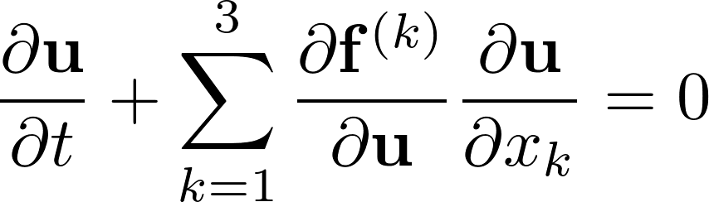
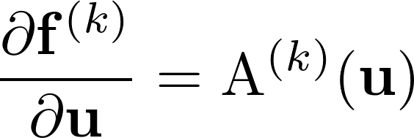
Code up Solvers
We must hide the complexity of mathematics, or the code will be messy.
Luckily, the CESE method can wrap the physical meanings in the Jacobian matrices of the quasi-linear form of the differential equations.
This can handle any physical process governed by hyperbolic PDEs (aka conservation lays).
I have incorporated solvers of gas dynamics, stress waves, and acoustics into a system: SOLVCON.
The back bone is a nested-loop structure, which should be employed by all such hyperbolic PDE solvers.
But in most codes this structure isn’t resolved. It is very difficult to maintain the codes.
The Jacobian
Notes:
In the previous two slides we get the idea the we are tackling a complex problem. The main matter here is how are we going to do with software. We must manage the complexity, and at the same time make the system as general as possible.
The numerical method I want to use is not only superb in the simulation results, it also provides a general mathematical framework to deal with any physical processes that are conservation laws. I made a software framework to take the mathematical framework, and applied it to simulate many physics. And today in this talk, I want to discuss 3 aspects of it.
1. The first is its basic architecture formed by using Python.
2. The second is the use of Cython for the language hybrid programming.
3. The third is the use of NumPy as a basis of numerical calculations.

Slide 12
Build a Framework in Python

Slide 13
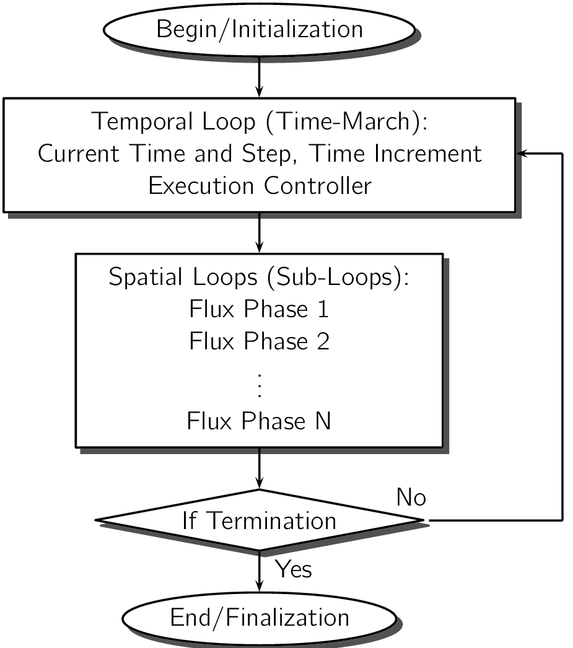
The Nested-Loop Structure
An outer loop controls time-marching: how the simulation steps forward in time.
Inside the temporal loop, the solver sweeps over the mesh data structure in multiple phases. I call each of the phases a spatial loop.
This is incarnated in a package called SOLVCON.
Notes:
It is well known that Python is very productive and easy to use. It makes it ideal to prototype a system. And once the system works, there’s nothing stops us from using it in real world. Therefore, Python helps us to make prototype to product.
Before we can make a system, we need to understand the most fundamental structure of the system. For a CFD solver, the basic structure is this nested loops. The solver needs to calculate values with respect to time and space. In time we call it time-march, and the time-marcher must be the outer loop. Inside the temporal loop we sweep the space multiple times, and we call the sweeps the spatial loop.

Slide 14
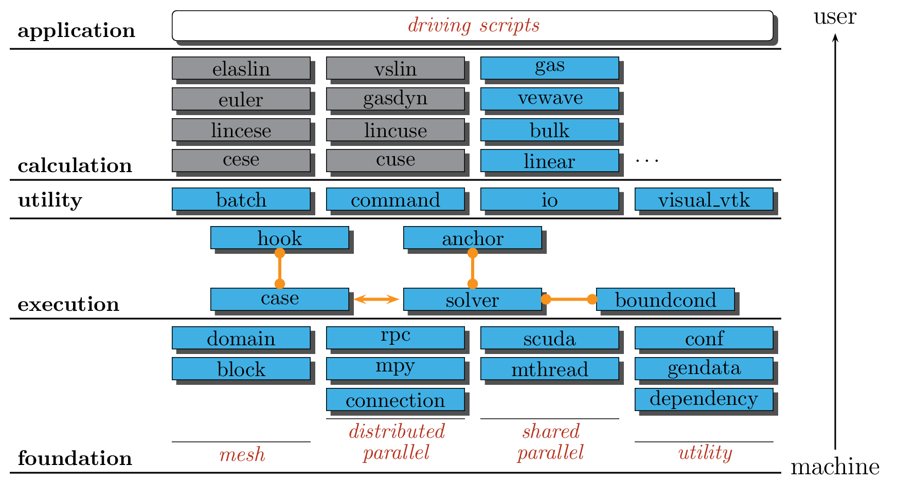
This is How Python Comes into Play
Designing a framework calls for high-level concepts, which are easily materialized in high-level languages.
The current architecture
Good structure.
Utmost performance.
Nested-loop structure
Notes:
The nested, two-level loop structure is conceptually simple, but it’s not easy to be realized in code. In SOLVCON, this is how I do it. I split all the modules into 4 layers, and on top of them, I use a Python “driving script” as an input file to drive the system. The “driving script” may consist of a single simulation, or many simulations. We are pretty flexible at this point.
We designed 5 modules to accommodate the nested loop structure. The loops are materialized in the “case” module and the “solver” module. In SOLVCON, a “case” object represents a simulation case, and in it we define the temporal loop. A “solver” is controlled by the “case” object, and we implement the spatial loops in solver classes. We have three other affiliated modules, and they are used to segregate code that doesn’t directly participate in the numerical methods. Next, we’ll see the important reason to use this multi-module architecture for the loops: code segregation.

Slide 15
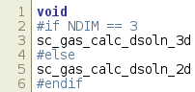
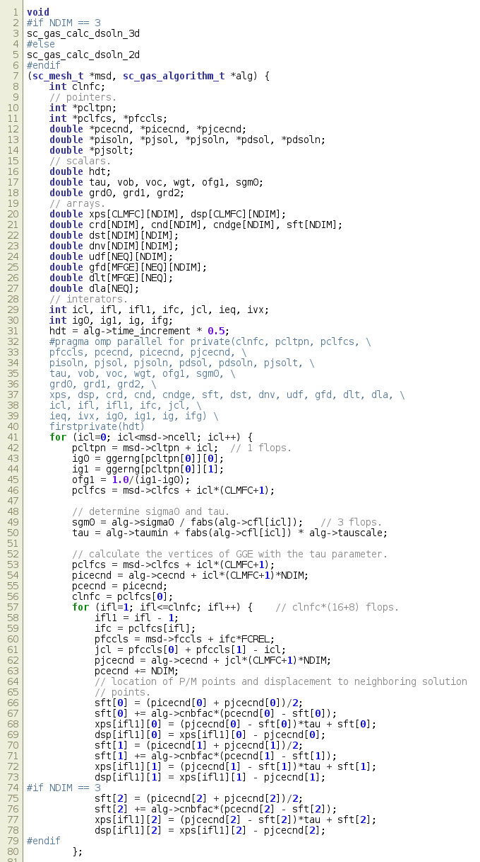
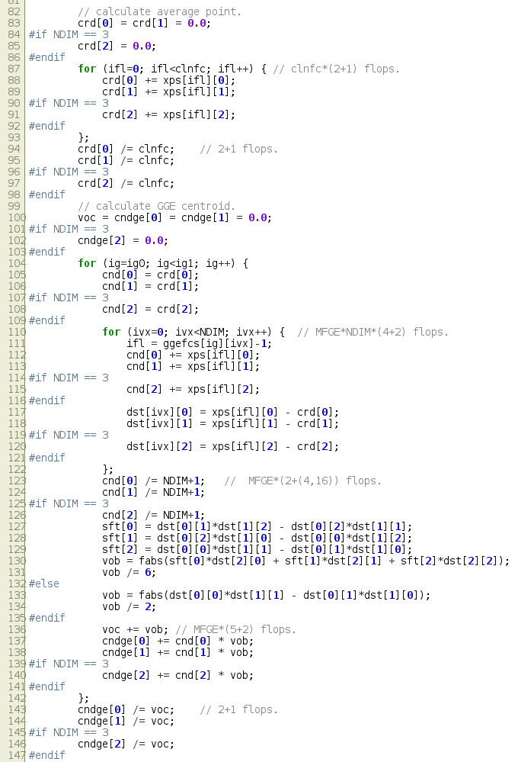
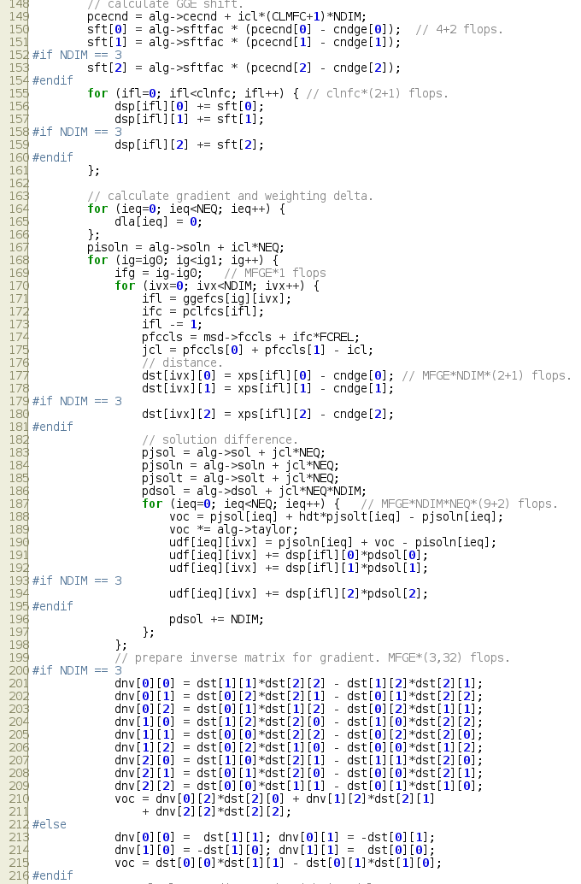
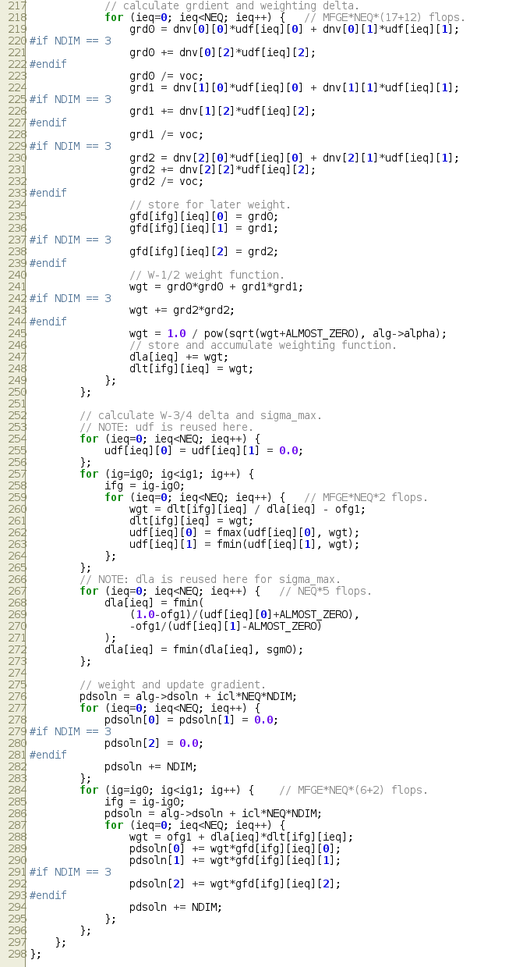
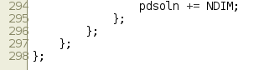
Segregation, Segregation, Segregation
This is part of a number-crunching kernel
It is well-organized
Imagine 3000 lines like this with little convention
Notes:
This is an example showing a spatial loop. This function has 300 lines of code. It doesn’t do any I/O and has a sole purpose of crunching numbers for the CESE method. If you look “closely”, you’ll find that there’s no “if’s” in the subroutine, so that we can make it fast.
In SOLVCON the architecture allows us to rip code like this into stand-alone subroutines. Imagine if we have 3,000 lines of C code like this, for both numerical methods and I/O, and perhaps something the one adds with creativity. We would have many cursing nights to deal with that code.

Slide 16
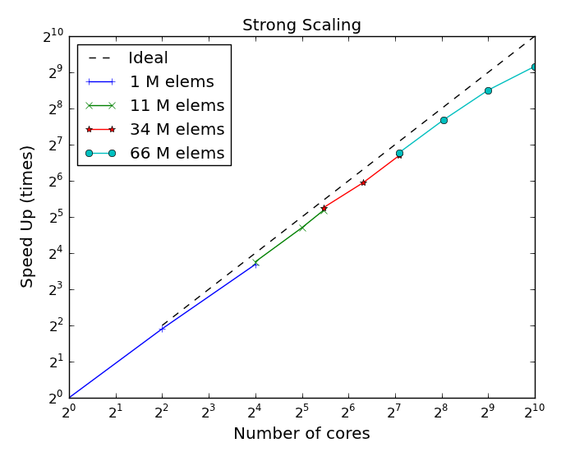
No Clock Should Be Wasted
66 million elements
53 hours
66 slave nodes (quad-core)
264 cores
13992 core-hours
Run this on EC2 could cost USD 300 to 1,000.
When you need this much computing power, you want no waste.
Notes:
When dealing with CFD code, we need to remember it needs to run super fast. We can do all the segregation and engineering we want, with a dogmatic requirement: no compromise to performance at all. This benchmark used up to 1000 CPU cores. I pick one simulation as an example. It used 66 quad-core slave machines and took 53 hours to complete, so the totally resources spent was 13992 core-hours. This study was done several years ago and I haven’t rerun them on a modern cloud service. But if I try to roughly estimate by a corresponding AWS machine, let’s say c4.xlarge, which equips 4 vCPU, this simulation would cost USD 731. Such simulations need to be run on a regular basis to assist aerodynamic studies. Now you see why CFD people are serious about performance! And why they need dedicated support from supercomputers.

Slide 17
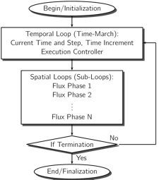
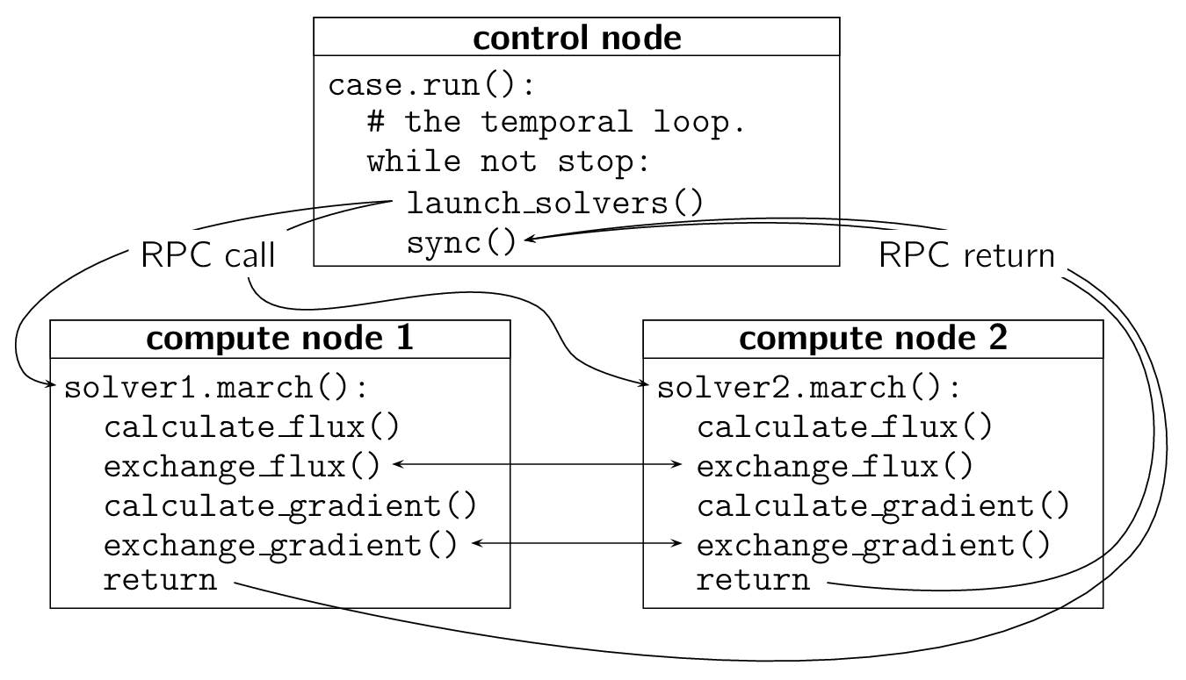
Spatial Loops Executed on Remote Slaves
Parallel computing is hard.
Parallel computing on multiple servers is harder.
SOLVCON defines a class MeshCase to orchestrate the simulation in the control node.
It mandates the basic nested-loop structure.
In slave nodes SOLVCON defines a class MeshSolver to implement spatial loops.
It is the number-crunching work horse on the slave nodes.
The case-solver distinction serves two purposes:
Segregate the numerical code (in solver) from the control code (in case).
Implement remote execution.
Notes:
One important point I want to make in the software architecture is parallel computing. Remember that we made a distinction between simulation “case” and a simulation “solver”? The distinction is important to segregate code for distributed-memory parallel computing. If we categorizing roughly, there are two types of parallel computing. The first type is relatively straight-forward, I call it shared-memory parallel computing. All your parallel units run in a single addressing space for accessing memory. Therefore when there’s a need for data synchronization, the easiest way is to share memory. There are some framework for shared-memory parallel computing, including threading, OpenMP, CUDA, OpenCL, et cetera. The second type is distributed-memory parallel computing, and it is what we need in CFD code. The parallel units run in different addressing space, and you need explicit communication to synchronize data. Distributed-memory parallel code is much harder to write and debug. By the way, we shouldn’t misunderstand distributed-memory parallel computing with distributed computing or processing. The latter, the so-called DP, usually doesn’t require data synchronization, and it doesn’t care the execution order of the tasks. But when we need distributed-memory parallel computing, like our CFD code, the processes are highly coupled to each other and need to synchronize frequently. In my case, each process needs to synchronize with its neighbors four times for marching one time step.

Slide 18
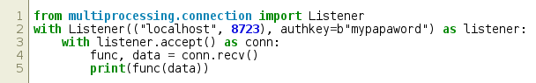
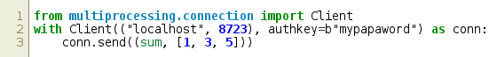
Remote Execution
The de facto infrastructure for massive parallelism is MPI (Message Passing Interface).
MPICH, OpenMPI, MVAPICH (this supports RDMA), etc.
In Python, the de facto wrapper is mpi4py.
Python standard library package provides a simple RPC framework:
In the slave node run the worker process:
In the controller node run the commanding process:
Notes:
To accomplish distributed-memory parallel computing, we need a mechanism to pass data. The de facto standard of doing it for high-performance computing is MPI, message passing interface. And in Python there’s package called mpi4py serves as a de facto wrapper for MPI libraries.
And now, at the last slide in this section, we finally got the first appearance of Python code. I think many of us may know that in Python standard library there’s a package called multiprocessing. It is mostly know as a way to work around the GIL. Because of GIL, Python threads cannot utilize all CPUs on a host because some important facilities in the interpreter acquires the lock. multiprocessing allows you to work around that by moving tasks from threads to processes. It provides some synchronization primitives so that you can exchange data among processes.
But that’s not the point! I am not sure how many of you know that multiprocessing can do RPC across network. This slide shows an example that how to set up a slave node that takes the function and data from the control node, and execute it. There are limitations, of course, but it’s quite fascinating to do this using only 8 lines of code using only standard libraries in Python, isn’t it? Things like this facilitated a lot of development in my CFD work.

Slide 19
Implement as a Hybrid System
Notes:
So I finally am prepared to talk about Python. This is the second technical part of this talk, and I am going to show how Cython can help us to build a hybrid language system.

Slide 20
Languages Involved
SOLVCON’s Top-Down Strategy
Python: The framework
C: The number cruncher
Cython: Bridge Python and C
ctypes is useful too, but Cython is more robust and versatile.
Data structures are defined in Python
A Bottom-Up Strategy
C++: Fast low-level code
Boost.Python or similar: Selective exposure of the low-level API
Python: Wrapper for scripting
Data structures are defined in C++
Notes:
In general building a hybrid system we have two strategies. In SOLVCON I took the first one, going from high-level to low-level. I first code in Python, and replace performance hot spot by writing low-level C code. Between the high and low levels I use Cython to interface. If you want to be more productive in prototyping, you may use ctypes, which is already in Python standard library, or other tools like cffi. SOLVCON used ctypes before, but in terms of type safety and maintainability, Cython is much better than ctypes.
The other way is to build from bottom up. This strategy works when you want a solid low-level system and expect it to be reused for other high-level languages. If you take this approach, most likely that you’ll write some profound C++ code using a lot of template meta-programming for speed, and then wrap it for Python using Boost.Python or something. Cython also works for this, but Boost.Python could be the most convenient tool for bridging C++ and Python.

Slide 21
C Is the King for Speed
System looks like Python, works like Python, but is C inside.
C is used inside the spatial loops for performance.
I try to minimize API (function calls), and define it at the spatial loop
Inside a spatial loop, the C code iterates over all elements (cells) and calculates.
Rule of thumb for HPC code.
No function call.
No branch statement (“if”).
Minimal FPU usage.
C++ may significantly simplify (shorten) the code, but
C++11 came just recently.
C is difficult enough for Fortran coders.
Spatial loop for gradient
Return for next call
First cell
Second cell
.
.
.
Last cell
Notes:
I don’t think I need to convince anyone but Fortran programmers or assembly programmers that C can deliver the best performance. This is from the github page of SOLVCON. Github thinks that SOLVCON is only 55% of Python, but 26% of C.
The C code is used in heavy-weight calculations, mainly in the spatial loops. While iterating over all the spatial elements, we need very fast speed. There are some rules of thumb when writing the number-crunching code.
First, no function calls.
No “if’s”
Try to use as little multiplication and division as possible.
We should also optimize for caching, but it’s too large a topic to be a rule of thumb. Also, it “could” be good to use C++ to write the performance-demanding code, but we all know it’s difficult to write good C++, so I have stayed with C for quite a long time.

Slide 22
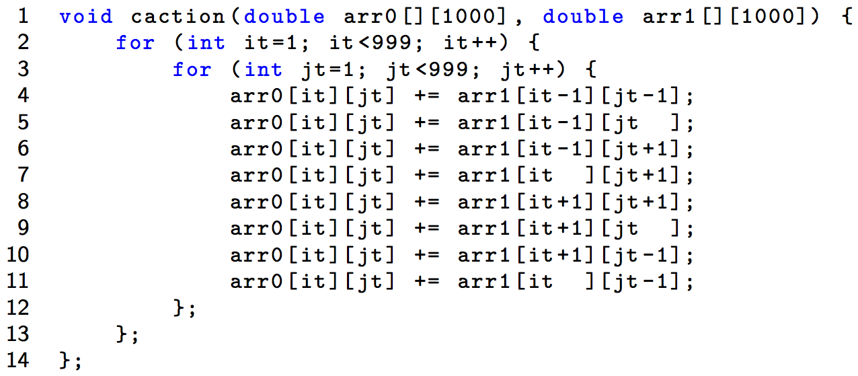
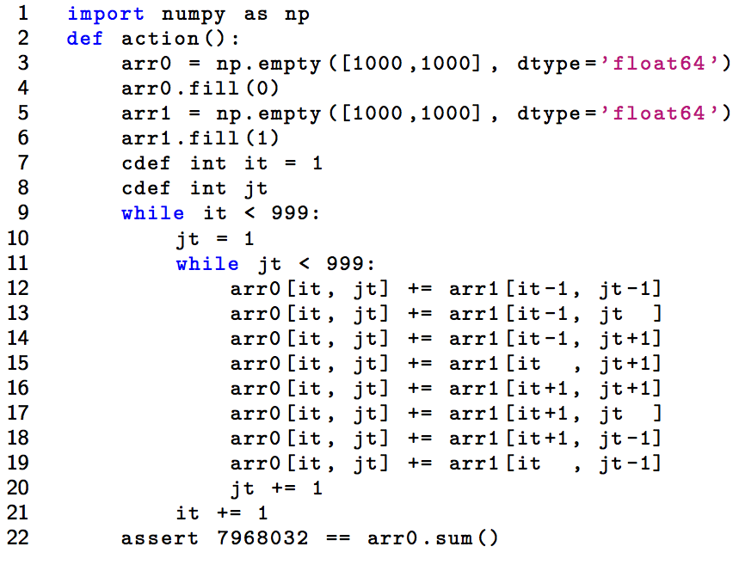
Python vs C
C version runs 51.4 milliseconds
Python version runs 5.74 seconds.
Python is 100x slower than C.
Use Python if you don’t care about number-crunching speed.
Notes:
This is one of my favorite benchmark, that shows how slow Python is. This is some meaningless calculation that sums together values for a rectangular mesh. Try to run the code, and you’ll find Python runs 100x slower than C. Two orders of magnitude. That can bring the $700 bill to $70000! I wish I get paid that much. So you know it’s really unrealistic to write number-crunching code in Python. It’s terrible, right? Any even worse, for number-crunching, Python isn’t any more beautiful than C. It’s too bad. We must do something.

Slide 23
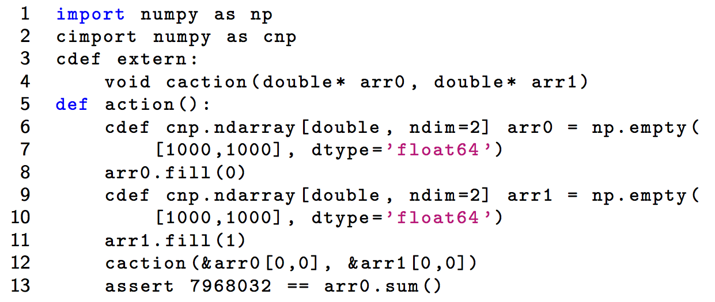
But We Want Minimal C
C code isn’t easy to maintain!
C++ code is even more difficult to maintain.
C should be only used in spatial loops.
Those loops take more than 99% of the total computing time. No compromise of performance.
Cython is the best tool to combine the two worlds.
This is our C function
Call our C function
Notes:
OK we agree that this that kind of code should be written in C, but we certainly don’t want to write everything in C because C would be ugly and hard to maintain for other work. In my case, and I would argue that in many cases, we can find performance hot spots and we can only bring that part into C. Cython is the best tool for this engineering.
For those who don’t know what is Cython, a simple explanation is that Cython is just a faster Python. It fully understand Python code, but can turn the Python opcodes into Python C API. By doing that we’ll gain a little bit performance, because we get rid of the interpreting loop. But Python the language apparently doesn’t know C. Cython augment that by adding typing and other stuff, so that it can compile the Python-like but augmented code directly into C, without invoking the Python interpreter.

Slide 24
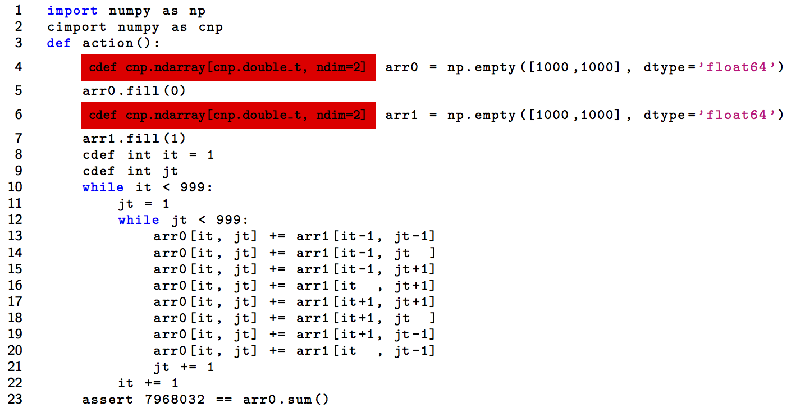
Cython Performance Is Good
For time-consuming code, Cython may be a good choice.
Trick 1: type variables. Trick 2: direct indexing.
139 milliseconds (C 51.4 milliseconds): Just 2.7 times slower than C.
Notes:
In addition to write C and interface with Cython, another choice is to write Cython in the “Cython way”, and let Cython to speed up for us. Here we use two techniques that Cython supports.
The first is typing. We let Cython know the type of variables that it is dealing with. Therefore Cython can generate C code directly, instead of Python object that requires Python C API, which is slow.
The second is telling Cython what the type and shape of the input array. By knowing this, Cython can index the array just like a plain memory buffer.
After these two changes, the Cython code sped up by 40 times against the Python version. Now it’s just 2.7 times slower than C. Considering the small effort we made, it’s not bad.

Slide 25
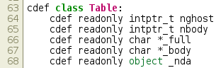
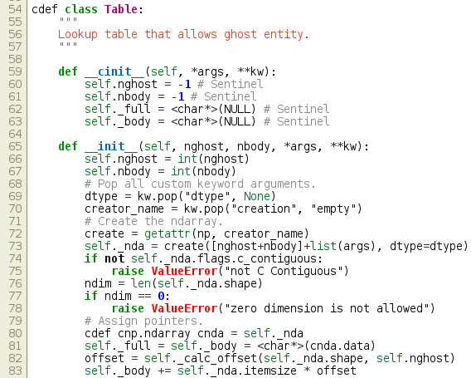
Define Classes in Cython
Easier OO in the hybrid system.
Declare C fields
Define classy wrapper
Notes:
Let me use two pages to show more advanced way to use Cython. In Cython you can still define classes. Do you see the non-Python syntax in the red rectangles? They are what get Cython special. You cannot run this code using vanilla Python, but Cython can recognize them and compile the code into a Python C extension module. A Python C extension module is nothing more than a shared object that follows a convention that Python interpreter understands.
Cython lets you access C data in a Cython class, and you can also have C fields for such a class.

Slide 26
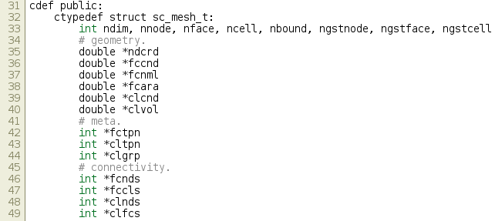
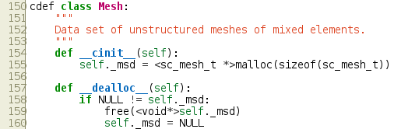
Use C struct
Define C struct
Use it in Cython/Python
Notes:
Moreover, we can define a C struct in Cython and use it from both Cython and C.

Slide 27
Recap Cython
For CFD we are obstinate at speed.
But we don’t want 6000 lines of Fortran playing with GOTO. Bus factor at nightmare level.
Python is very good for architecting. We use Cython to make it work with fast C kernels.
The hybrid system runs as fast as a pure Fortran reference. Sometimes faster.
Vanilla Python is 100x slower than C.
Cython when used correctly can deliver comparable speed to C.
Cython helps a Python-based system to achieve C speed, and makes the C code look classy in Python.
It significantly reduces the boilerplates, but there are still constraints.
C++ would remove the constraints, but bring other issues to a project.
Notes:
This is a simple introduction to Cython. I didn’t show you how to install it or invoke it. If you want to know, I can tell you the best practice later after the talk. The short answer is to just use Anaconda on Linux or Mac, and stay away from Windows before the Linux in Windows is shipped.
The much more important things here is to know how to characterize if your system is suitable for Cython. If you are architecting something new, and you know later you’ll need speed, what you should do is to segregate the performance hot spot. If you are successful at it, you can expect 10x speed-up by converting the hot spot to Cython. As long as you make the API clear, later you can replace it with C and further improve the performance.

Slide 28
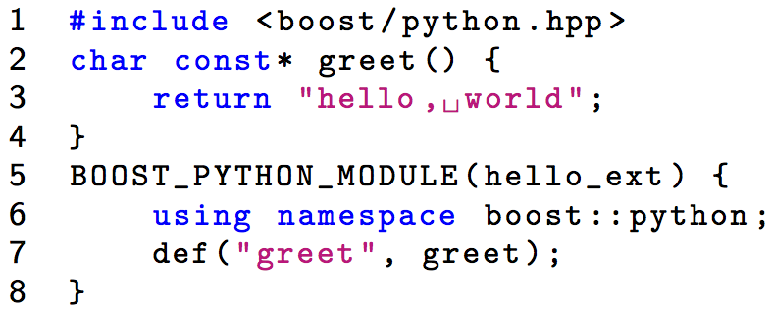
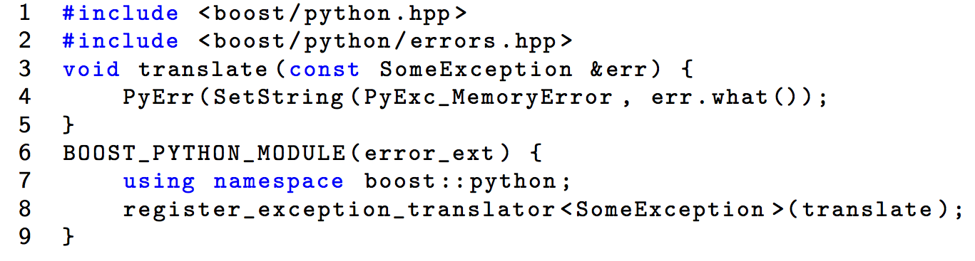
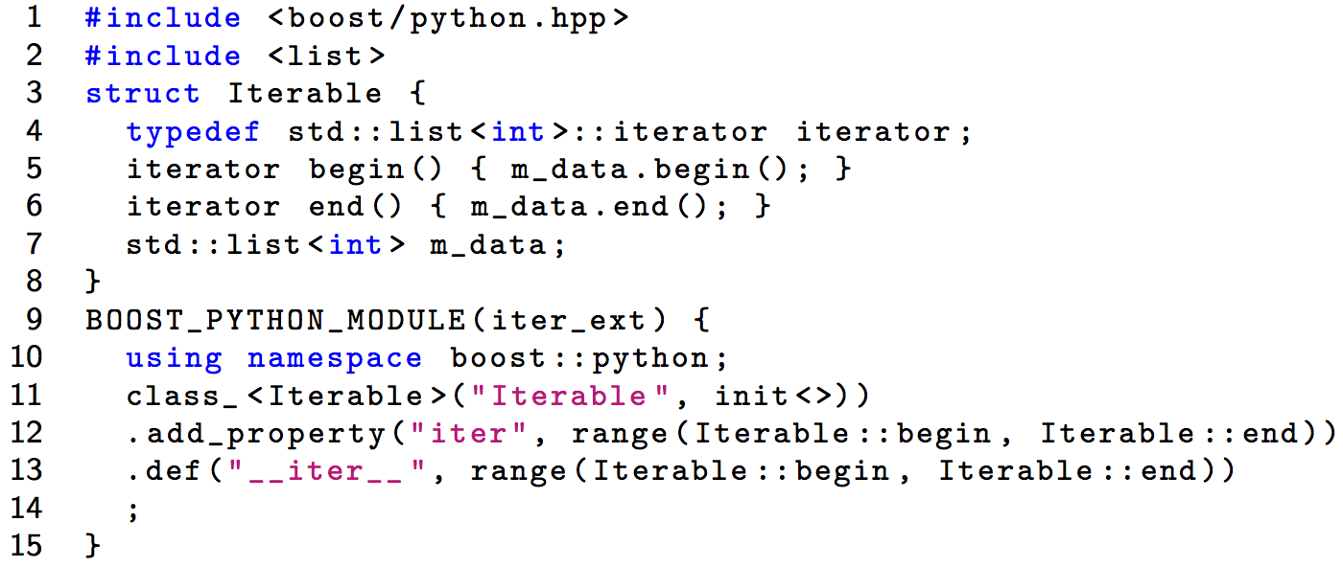
Boost.Python
A hello world
Boost.Python use C++ templates to create the boilerplate needed by a Python module.
It handles Python facilities well, e.g.,
Exception
Iterator
NumPy ndarrays needs special care.
Notes:
Before we leave this part, I use this final page to say a word on Boost.Python. If you have a C++ system and want a Python interface, considering this tool. If you are a C++ developer, most likely that you are already using boost. Boost.Python is part of the library, and allows you to wrap everything between C++ and Python in two directions. The only bad news is NumPy support is limited. And in the next part, you’ll know why this is a bad news.

Slide 29
NumPy and Arrays

Slide 30
NumPy
NumPy package is a foundation of most scientific Python tools.
It defines ndarray: The data structure of typed memory buffers.
It influenced Python buffer protocol and memory view.
Cython provides its own typed memory view.
Arrays (contiguous memory buffers) are the basics of HPC.
Typing is necessary. For CFD number-crunching floating-points are the key.
Interesting things are the multi-dimensional arrays.
NumPy makes them very easy to use. ndarray means N-dimensional array.
Managing them in C is painful.
C++ smart pointers make managing them less painful, but far away from convenient.
Basic capabilities:
Creation.
Shaping, typing, combining, splitting, etc.
Notes:
In the third technical part, I want to introduce NumPy. NumPy is an old package, and has been the de facto foundation of most scientific Python tools. The most important offering is its ndarray, which means N-dimensional array. You can see it as a typed memory buffer. It makes Python a wonderful platform for numerical calculations. If you ever programmed in Fortran, you’ll know how convenient the Fortran arrays are. Because of the arrays, some Fortran code can outperform C, because C lacks the facility and sometimes programmers don’t do a good job optimize the arrays by hands.
Array may be the most simple data structure. But in this part, I’d like to show you how NumPy makes the manipulation beautiful.

Slide 31
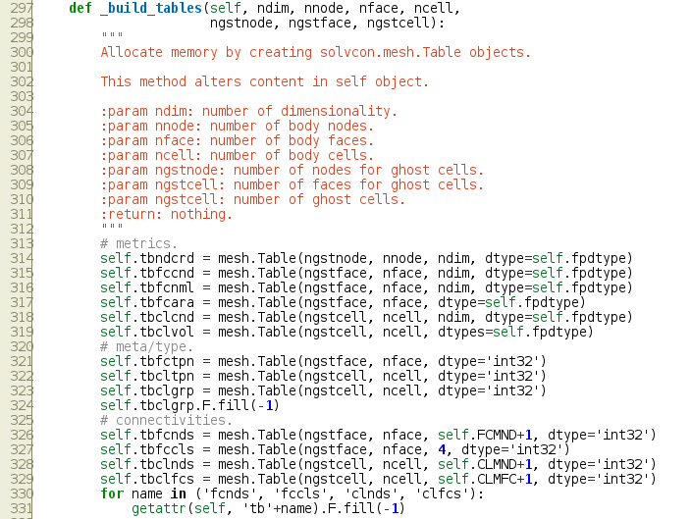
Data in Look-Up Tables
Look-up tables are low-level data structures optimized for reading.
ndarray works perfectly for such use cases.
Notes:
First I quickly show you how I use ndarray in my CFD calculation. I need a lot of look-up tables that store cross-referenced data. It’s not only useful in Python. Cython support ndarray and allow zero-copy of the memory buffer, so that I can access the same data behind the arrays in both Python and C.

Slide 32
Popular Creation API
empty(): Create an untouched buffer.
zeros(): Create a buffer using calloc.
arange(): Fill the buffer like range().
array(): Fill the buffer using the input container.
It’s a convention to write “import numpy as np”.
>>> import numpy as np
>>> np.empty(5, dtype='float64')
array([ 0.00000000e+000, 0.00000000e+000, 2.13235710e-314,
2.12311406e-314, 0.00000000e+000])
>>> np.zeros(5, dtype='float64')
array([ 0., 0., 0., 0., 0.])
>>> np.arange(5, dtype='float64')
array([ 0., 1., 2., 3., 4.])
>>> np.array([3, 7, 5, -1, 0], dtype='float64')
array([ 3., 7., 5., -1., 0.])
Notes:
Let’s start with creation.

Slide 33
Reshape Arrays
reshape(): Change to any shape.
>>> arr = np.arange(6, dtype='int32')
>>> arr.reshape((2,3))
array([[0, 1, 2],
[3, 4, 5]], dtype=int32)
>>> arr.reshape((2,3))[0,0] = 7
>>> arr
array([7, 1, 2, 3, 4, 5], dtype=int32)
>>> arr.reshape((2,4))
Traceback (most recent call last):
File "<stdin>", line 1, in <module>
ValueError: total size of new array must be unchanged
reshaped array is just a view
cannot change number of elements
flatten(): Copy to a flat array.
>>> brr = arr.reshape((2,3))
>>> brr.flatten()
array([7, 1, 2, 3, 4, 5], dtype=int32)
>>> brr.flatten()[0] = 70
>>> brr
array([[7, 1, 2],
[3, 4, 5]], dtype=int32)
doesn’t change original
ravel(): Create a flat view.
>>> brr.ravel()
array([7, 1, 2, 3, 4, 5], dtype=int32)
>>> brr.ravel()[0] = 70
>>> brr
array([[70, 1, 2],
[ 3, 4, 5]], dtype=int32)
change original
Notes:
If everything’s in one dimension the world isn’t interesting at all. NumPy allows us to reshape an array. But it’s important to know that reshaping only changes the meta-data, not the array contents. Therefore a reshaped array is just a “view” of the original array, with a different shape definition. In addition to reshape, NumPy also provide two methods to turn the arrays back to 1D, or flattened.

Slide 34
Cast Array
astype(): Cast array elements to a new array.
>>> arr
array([70, 1, 2, 3, 4, 5], dtype=int32)
>>> arr.astype('float64')
array([ 70., 1., 2., 3., 4., 5.])
>>> arr.astype('float64')[5] = 100
>>> arr
array([70, 1, 2, 3, 4, 5], dtype=int32)
tolist(): Shorthand to make a Python list. 80% faster than list().
$ python -m timeit -s "import numpy as np; arr=np.arange(100000)" "arr.tolist()"
100 loops, best of 3: 2.48 msec per loop
$ python -m timeit -s "import numpy as np; arr=np.arange(100000)" "list(arr)"
100 loops, best of 3: 4.39 msec per loop
Data I/O.
>>> crr = np.fromstring("1, 3, 5, 7, 9, 2, 4, 6, 8, 10", sep=",")
>>> np.save("crr.npy", crr)
>>> np.load("crr.npy")
array([ 1., 3., 5., 7., 9., 2., 4., 6., 8., 10.])

Slide 35
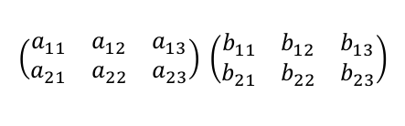
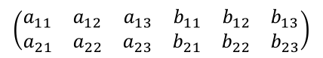
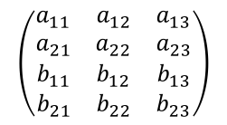
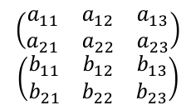
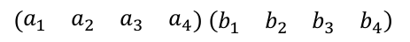
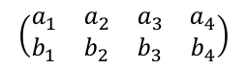
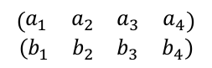
Combine Arrays
hstack(): Stack along row
vstack(): Stack along column
$$\left(\begin{matrix}a_{11} & a_{12} & a_{13} \\ a_{21} & a_{22} & a_{23}\end{matrix}\right) \left(\begin{matrix}b_{11} & b_{12} & b_{13} \\ b_{21} & b_{22} & b_{23}\end{matrix}\right)$$
$$\left(\begin{matrix}a_{11} & a_{12} & a_{13} \\ a_{21} & a_{22} & a_{23}\end{matrix}\right)$$
$$\left(\begin{matrix}b_{11} & b_{12} & b_{13} \\ b_{21} & b_{22} & b_{23}\end{matrix}\right)$$
$$\left(\begin{matrix}a_{11} & a_{12} & a_{13} \\ a_{21} & a_{22} & a_{23} \\ b_{11} & b_{12} & b_{13} \\ b_{21} & b_{22} & b_{23}\end{matrix}\right)$$
$$\left(\begin{matrix}a_{11} & a_{12} & a_{13} & b_{11} & b_{12} & b_{13} \\ a_{21} & a_{22} & a_{23} & b_{21} & b_{22} & b_{23}\end{matrix}\right)$$
$\left(\begin{matrix}a_{1} & a_{2} & a_{3} & a_{4}\end{matrix}\right)$ $\left(\begin{matrix}b_{1} & b_{2} & b_{3} & b_{4}\end{matrix}\right)$
$$\left(\begin{matrix}a_{1} & a_{2} & a_{3} & a_{4}\end{matrix}\right)$$
$$\left(\begin{matrix}b_{1} & b_{2} & b_{3} & b_{4}\end{matrix}\right)$$
$$\left(\begin{matrix}a_{1} & a_{2} & a_{3} & a_{4} \\ b_{1} & b_{2} & b_{3} & b_{4}\end{matrix}\right)$$
$$\left(\begin{matrix}a_{1} & a_{2} & a_{3} & a_{4} & b_{1} & b_{2} & b_{3} & b_{4}\end{matrix}\right)$$
>>> arr = np.arange(6, dtype='float64').reshape((2,3))
>>> brr = np.arange(6, 12, dtype='float64').reshape((2,3))
>>> arr
array([[ 0., 1., 2.],
[ 3., 4., 5.]])
>>> brr
array([[ 6., 7., 8.],
[ 9., 10., 11.]])
>>> np.hstack((arr,brr))
array([[ 0., 1., 2., 6., 7., 8.],
[ 3., 4., 5., 9., 10., 11.]])
>>> np.vstack((arr,brr))
array([[ 0., 1., 2.],
[ 3., 4., 5.],
[ 6., 7., 8.],
[ 9., 10., 11.]])
>>> a1rr = np.arange(4, dtype='float64')
>>> b1rr = np.arange(4, 8, dtype='float64')
>>> a1rr
array([ 0., 1., 2., 3.])
>>> b1rr
array([ 4., 5., 6., 7.])
>>> np.hstack((a1rr, b1rr))
array([ 0., 1., 2., 3., 4., 5., 6., 7.])
>>> np.vstack((a1rr, b1rr))
array([[ 0., 1., 2., 3.],
[ 4., 5., 6., 7.]])
horizontal
stack
vertical stack
>>> np.concatenate((arr,brr))
array([[ 0., 1., 2.],
[ 3., 4., 5.],
[ 6., 7., 8.],
[ 9., 10., 11.]])
>>> np.concatenate((a1rr, b1rr))
array([ 0., 1., 2., 3., 4., 5., 6., 7.])
concatenate()
Notes:
Horizontal stacks along row (increasing column counts).
Vertical stacks along column (increasing row counts).

Slide 36
Slicing
Make use of Python slice
>>> arr = np.arange(6, dtype='float64')
>>> arr
array([ 0., 1., 2., 3., 4., 5.])
>>> arr[0::2]
array([ 0., 2., 4.])
>>> arr[::-1]
array([ 5., 4., 3., 2., 1., 0.])
Select a whole dimension or dimensions
>>> brr = np.arange(15, dtype='float64').reshape((3,5))
>>> brr
array([[ 0., 1., 2., 3., 4.],
[ 5., 6., 7., 8., 9.],
[ 10., 11., 12., 13., 14.]])
>>> brr[(0,2),:]
array([[ 0., 1., 2., 3., 4.],
[ 10., 11., 12., 13., 14.]])
>>> crr = np.arange(24,
... dtype='float64').reshape((2,3,4))
>>> crr
array([[[ 0., 1., 2., 3.],
[ 4., 5., 6., 7.],
[ 8., 9., 10., 11.]],
[[ 12., 13., 14., 15.],
[ 16., 17., 18., 19.],
[ 20., 21., 22., 23.]]])
>>> crr[...,(0,2)]
array([[[ 0., 2.],
[ 4., 6.],
[ 8., 10.]],
[[ 12., 14.],
[ 16., 18.],
[ 20., 22.]]])
Select only two rows
Select two groups in the last dimension

Slide 37
Indexing Using Boolean Arrays
Logical operators return a Boolean array as a “selector”.
>>> arr = np.arange(6, dtype='float64')
>>> arr
array([ 0., 1., 2., 3., 4., 5.])
>>> slct = arr < 3
>>> slct
array([ True, True, True, False, False, False], dtype=bool)
>>> arr[slct]
array([ 0., 1., 2.])
>>> slct = (arr < 3) | (arr > 4)
>>> slct
array([ True, True, True, False, False, True], dtype=bool)
>>> arr[slct]
array([ 0., 1., 2., 5.])
The shapes must be identical
>>> slct = np.concatenate((arr < 3, arr > 4))
>>> slct
array([ True, True, True, False, False, False, False, False, False,
False, False, True], dtype=bool)
>>> arr[slct]
Traceback (most recent call last):
File "<stdin>", line 1, in <module>
IndexError: index 11 is out of bounds for axis 1 with size 6

Slide 38
The Rest
Python Takes You Far

Slide 39
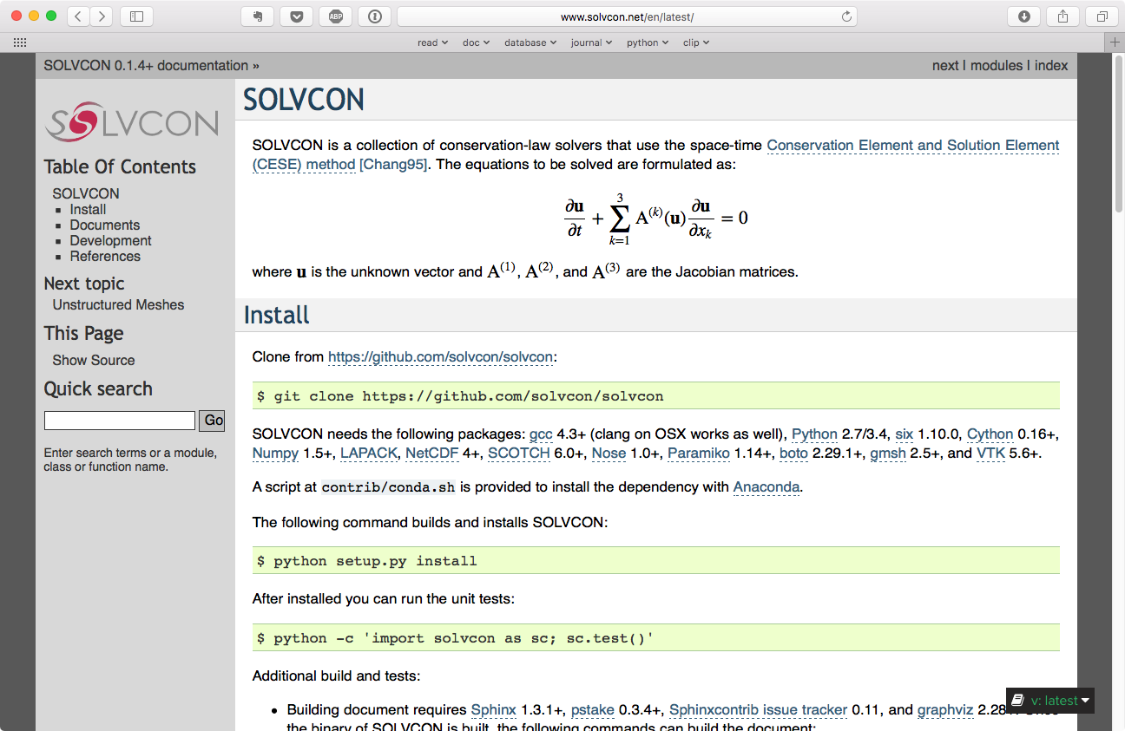
Documentation
Sphinx documents are good
Notes:
Most of the work about SOLVCON is done using Python. This is the website, and it uses Sphinx, which is also used to create the official Python documentation.

Slide 40
Python Speeds up Development
The simulations are simply Python scripts with delayed evaluation.
Users can calculate anything in the “input file”.
Simple route to in situ visualization.
No need to keep the 10TB data per run, and no need to reduce resolution in analysis.
Abundant 3rdparty libraries. Straight-forward I/O code.
77963 packages now.
Fast prototyping.
Python is indeed slow. But a proof of concept is so easy to code.
Jupyter notebook.
Rapidly prototype prototype code.
Wonderful analysis platform.

Slide 41
The Plan of Jobspace

Slide 42
What I Learned in 10 Years
The unimportant things are critical, and difficult.
“In order to be sustainable, dedicated resources must be allocated toward the formation of a streamlined and improved software development process that can be leveraged across various projects, lowering software development costs, and releasing researchers and developers to focus on scientific or algorithmic implementation aspects.” The second of the six recommendations in NASA/CR-2014-218178.
The Richtmyer paper was published in 1950.
Unimportant things lead to important things.
NumPy is made by an electrical engineer.
IPython is made by a physicist.
Pandas is made by a mathematician.
Notes:
CFD Vision 2030 Study: A Path to Revolutionary Computational Aerosciences

Slide 43
Have More Fun
It’s difficult to sort out complex things without writing it down.
I don’t fully understood an equation before deriving it enough times to memorize it.
Ideas sparkle in critical discussions.
Get together intelligent and enthusiastic people. Let people feel comfortable. Have fun.
Talk to each other analytically.
I want to invite more interesting talks to Jobspace.
Let’s enjoy the hard work of others.
Let’s enjoy the discussions to each other.
Thank you!

